Slide 1
Understanding cabinets globally through WhoGov
Dr Stuart Bramwell
Postdoctoral Researcher / Guest Lecturer
Royal Holloway, University of London / London School of Economics

Slide 2
WhoGov in a few facts and figures
The largest publicly available data set which provides individual level data on cabinet members.
56,063 elites in 177 countries from 1966 to 2021
Introduced in the American Political Science Review
Won the Lijphart / Przeworski / Verba data set prize conferred by the American Political Science Association in 2021

Slide 3
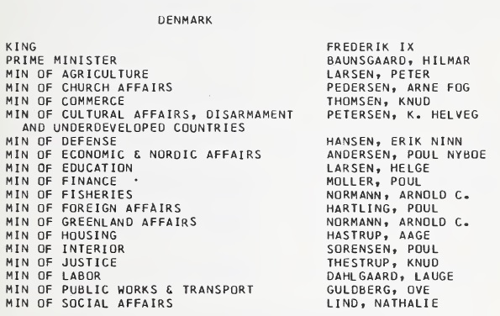
From directory to data
Positions and names are coded and standardised using machine learning and manual coding.
Bibliographic information such as gender, age, party affiliation, portfolio classification/type

Slide 4
From there, we add extra variables
Male / female gender
Party affiliation
Standardised portfolio classification
Paths to Power (Nyrup, Knutsen & Langsæther 2023)
Level of education, previous occupation, geographic origin

Slide 5
What have I found out from WhoGov that we did not know already?

Slide 6
Do democracies empower women more than autocracies?

Slide 7
“Women in Cabinets – WhoGov 2.0” Tableau dashboard

Slide 8
Do the political elite change after regime change?

Slide 9
Using the tidyverse to understand the cost of governing

Slide 10
Are governing parties punished in the next election?

Slide 11
Are governing parties punished in the next election?

Slide 12
Thanks for listening! Any questions?

